Slide 1
Programming 101 Day 6
Basic Web Design

Slide 2
Outline
HTML Tags
Styling
Layouting
HTML Manipulation through JS

Slide 3
HTML Tags & Styling

Slide 4
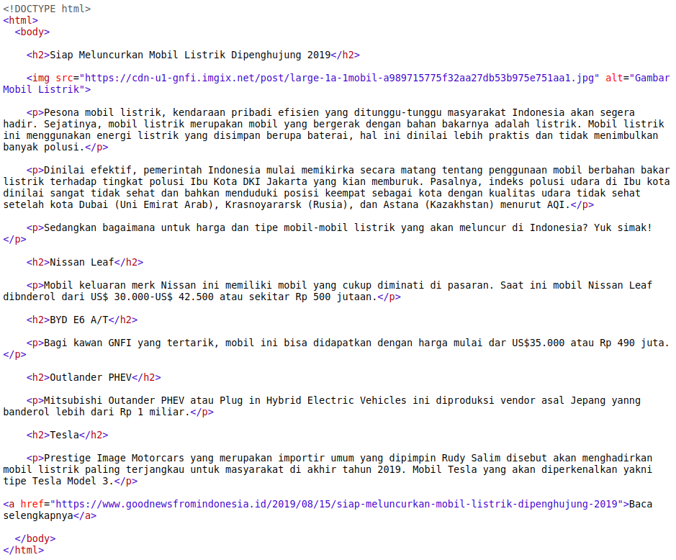
HTML Elements

Slide 5
HTML Attribute

Slide 6
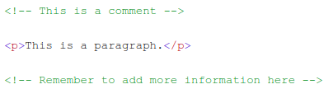
Comment

Slide 7
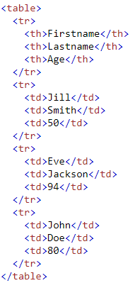
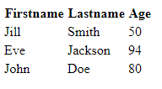
Table

Slide 8








List

Slide 9
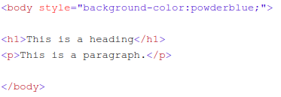



Style

Slide 10
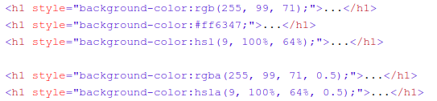
Colors

Slide 11
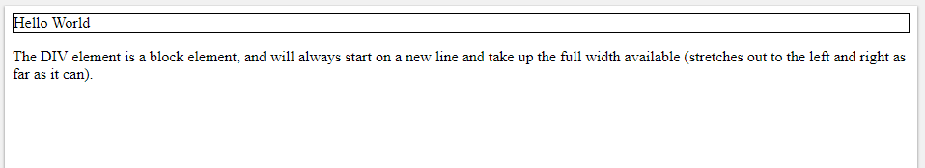
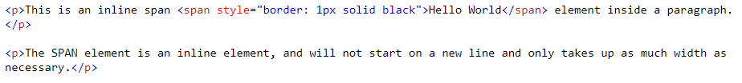
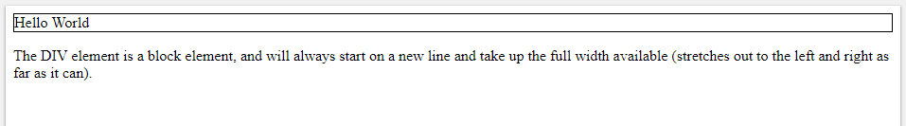
Blocks

Slide 12
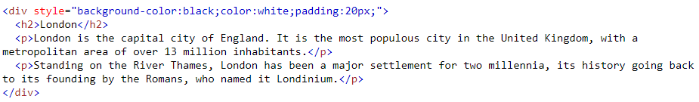
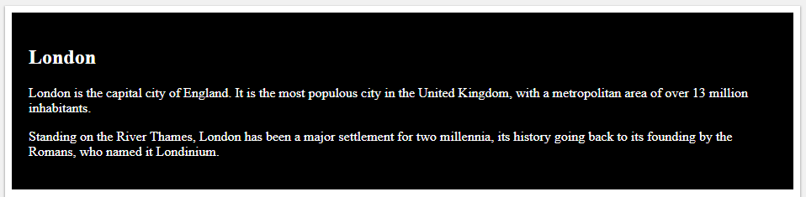
Blocks

Slide 13

Blocks

Slide 14
Layouting

Slide 15
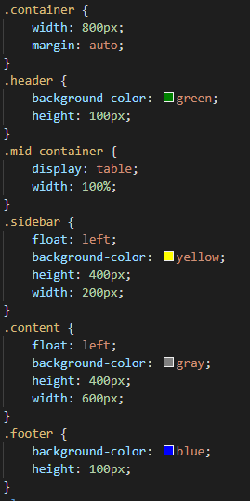
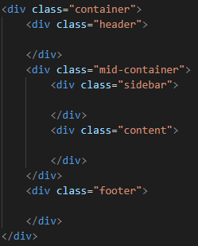

Slide 16


Slide 18
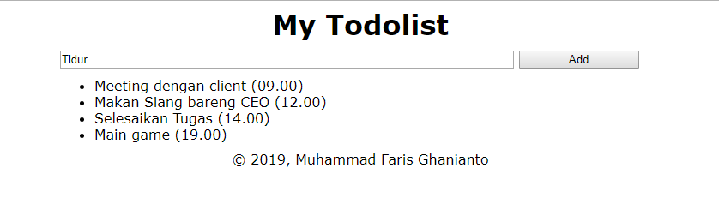
Keep Practicing!

Slide 19
“People ignore design that ignores people”
- Frank Chimero, Designer

